Slide 1
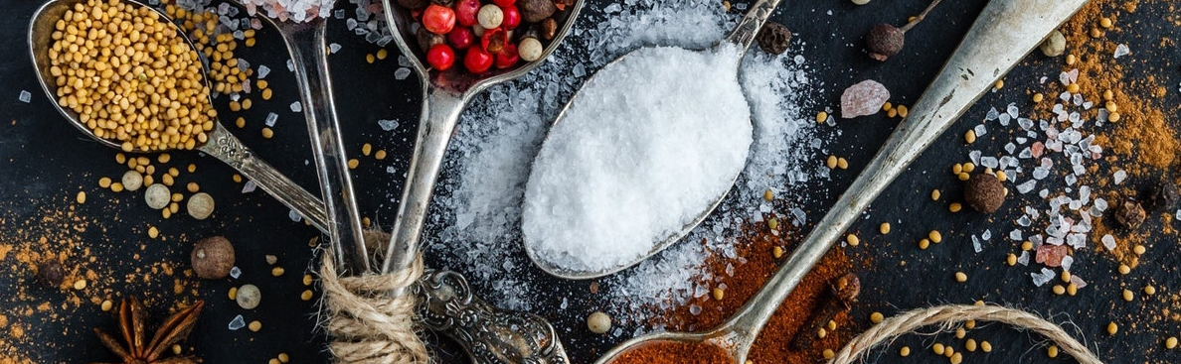
Perfect Your Steakhouse! based on Yelp review data Jiawei Wu, Yansong Mao, Zhoujingpeng Wei, Zheng Ni

Slide 2
Outline:
Introduction
Rating system based on reviews
Suggestion based on Attributes
Conclusion
shiny app

Slide 3
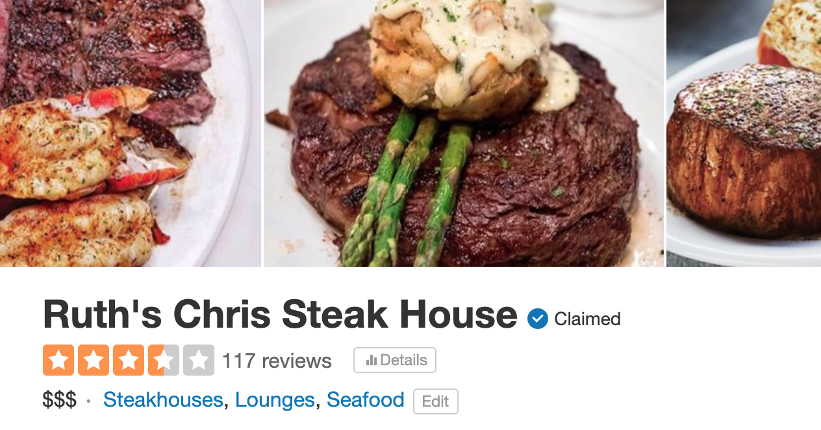
Steakhouses on Yelp

Slide 4
Preprocess on Review
Raw review: The food was very good . The waitress was very inventive . The only thing is my I felt so sick after eating it . I'm not sure if it's just my stomach not being able to handle it or what but I felt terrible . The staff at the front was very friendly and talkative.
Proccessed review: 'food', 'good', 'waitress', 'inventive', 'thing', 'felt', 'sick', 'eat', 'sure', 'stomach', 'able', 'handle', 'felt', 'terrible', 'staff', 'front', 'friendly', 'talkative'.

Slide 5
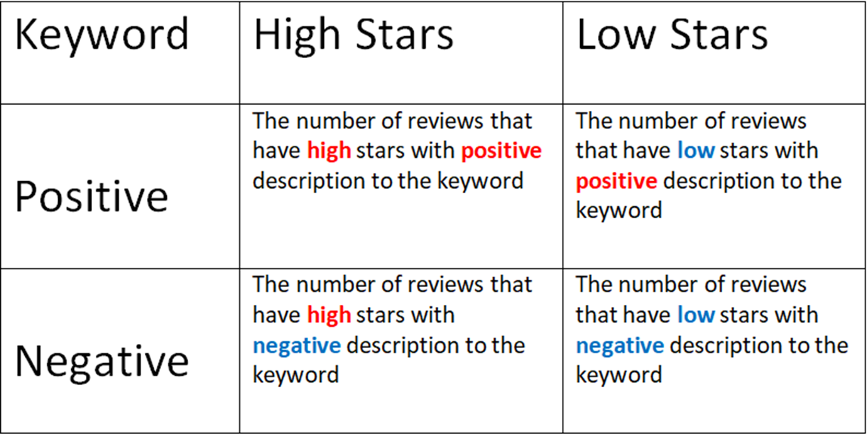
Hypothesis test
Categories: Keyword
Food : Steak, dessert, appetizer.
Drink : beverage, wine, beer.
Service : service, manager.
Time : time, wait.
Price : price, expensive, affordable.

Slide 6
Business ID | Review ID | Review Stars | Food | Service | Time | Drink | Price
ID_1 | Review 1 | 4 | #1 : 4 | #2 : 3.5 | Null | #3 : 3 | Null
 | Review 2 | 5 | #2 : 4.5 | Null | Null | #1 : 5 | Null
 | ………
 | Review N | 3 | #1 : 3 | Null | Null | Null | Null
For every business ID, we rank the five kinds of words by the ratio of positive words between negative words.
we compute the average stars for each categories of keywords. The we can get average stars in these five aspects for every steakhouse.

Slide 7
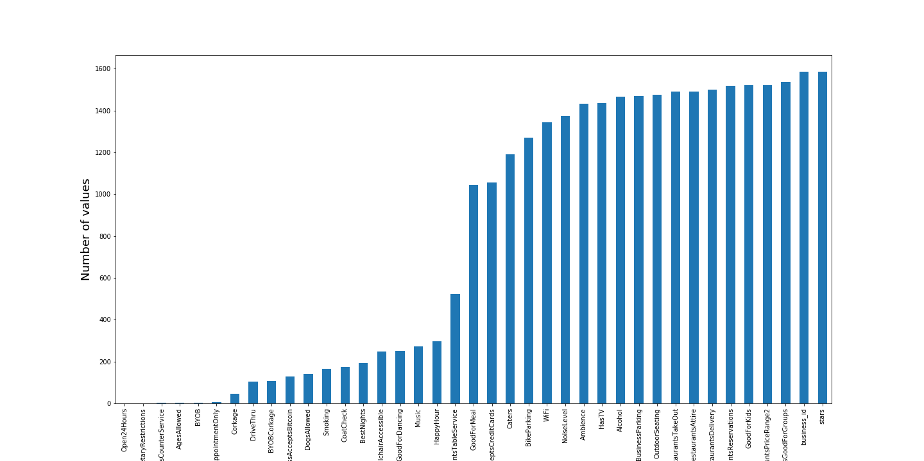
Attributes Analysis Remove attributes with huge missing values------18 attributes remained

Slide 8
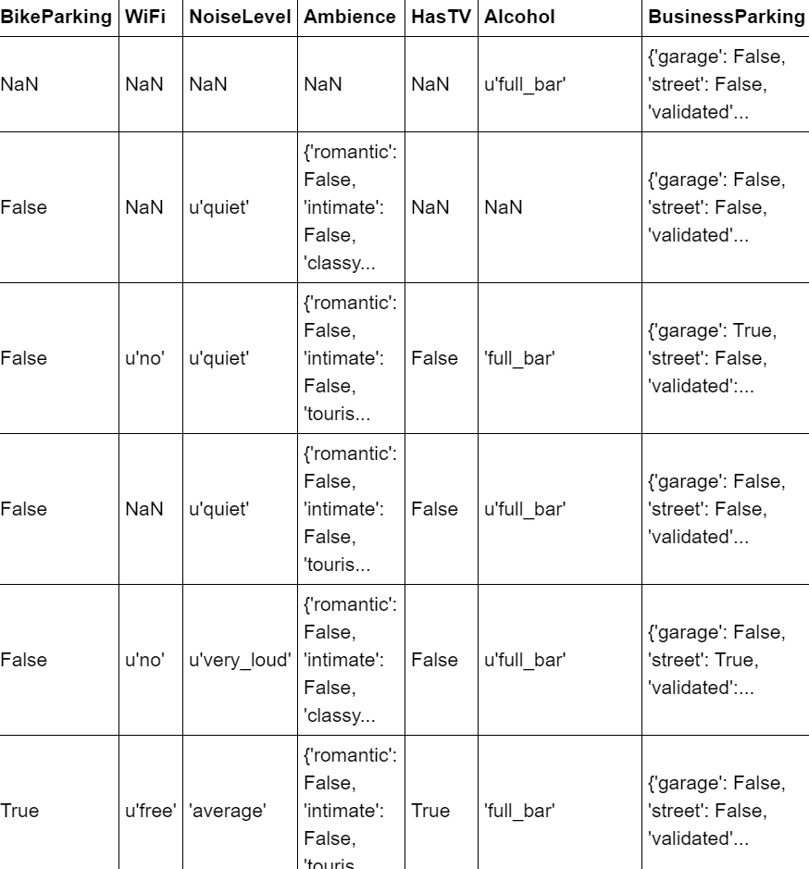
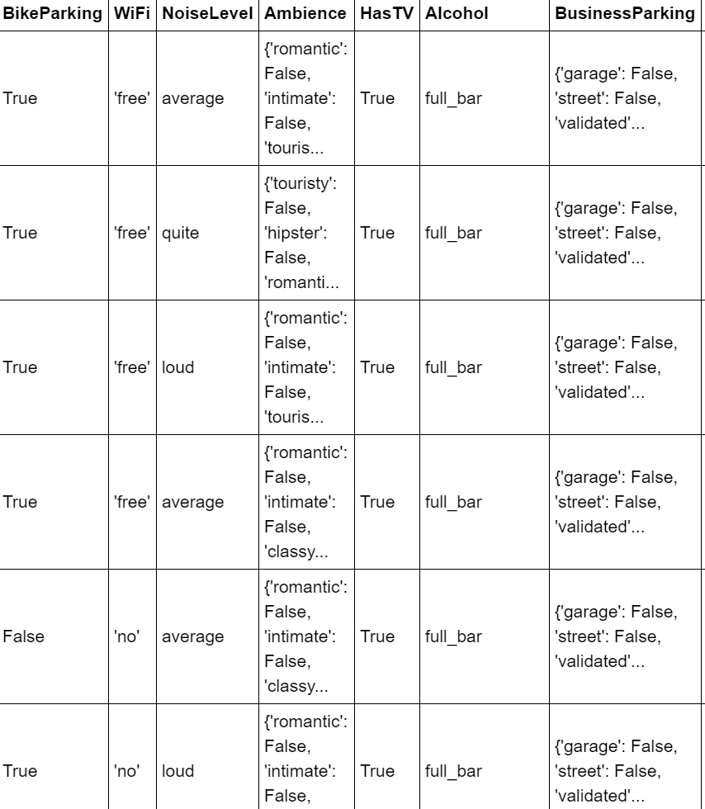
Imputation and Decision Tree

Slide 9
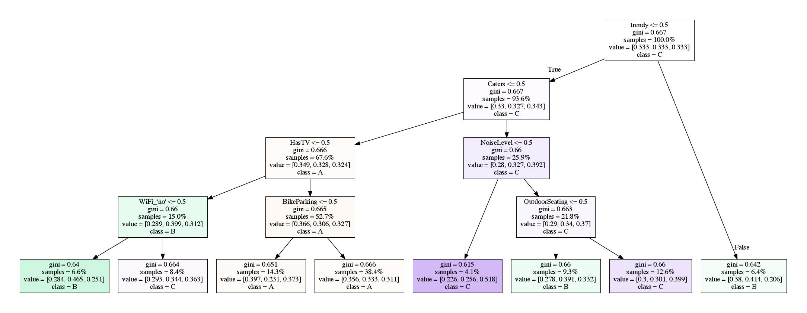
Imputation and Decision Tree
Class A: #570 stars 1-3
Class B: #456 stars 3.5
Class C: #559 stars 4-5

Slide 10
Strength and Weakness
Strength:
1. Our system provides simple, direct and powerful plots for both the steakhouse owners and potential costumers to know the strength and weakness of the steakhouses.
2. For the rating system, we add punishment to reduce the bias produced by the two-faced reviews(contain both compliment and criticism).
Weakness:
1. Our results depend on the number of the reviews for each steakhouse. For those steakhouses who has few reviews, our system will show some biases.
2. It is hard to interpret tree method outcome objectively, which contains some subjective factors.
3. It would be better if we can split all steakhouses into two parts: high-end restaurant and cheap restaurant.

Slide 11
Shiny
Link: https://aurorawu1996.shinyapps.io/yelp_review/

Slide 12
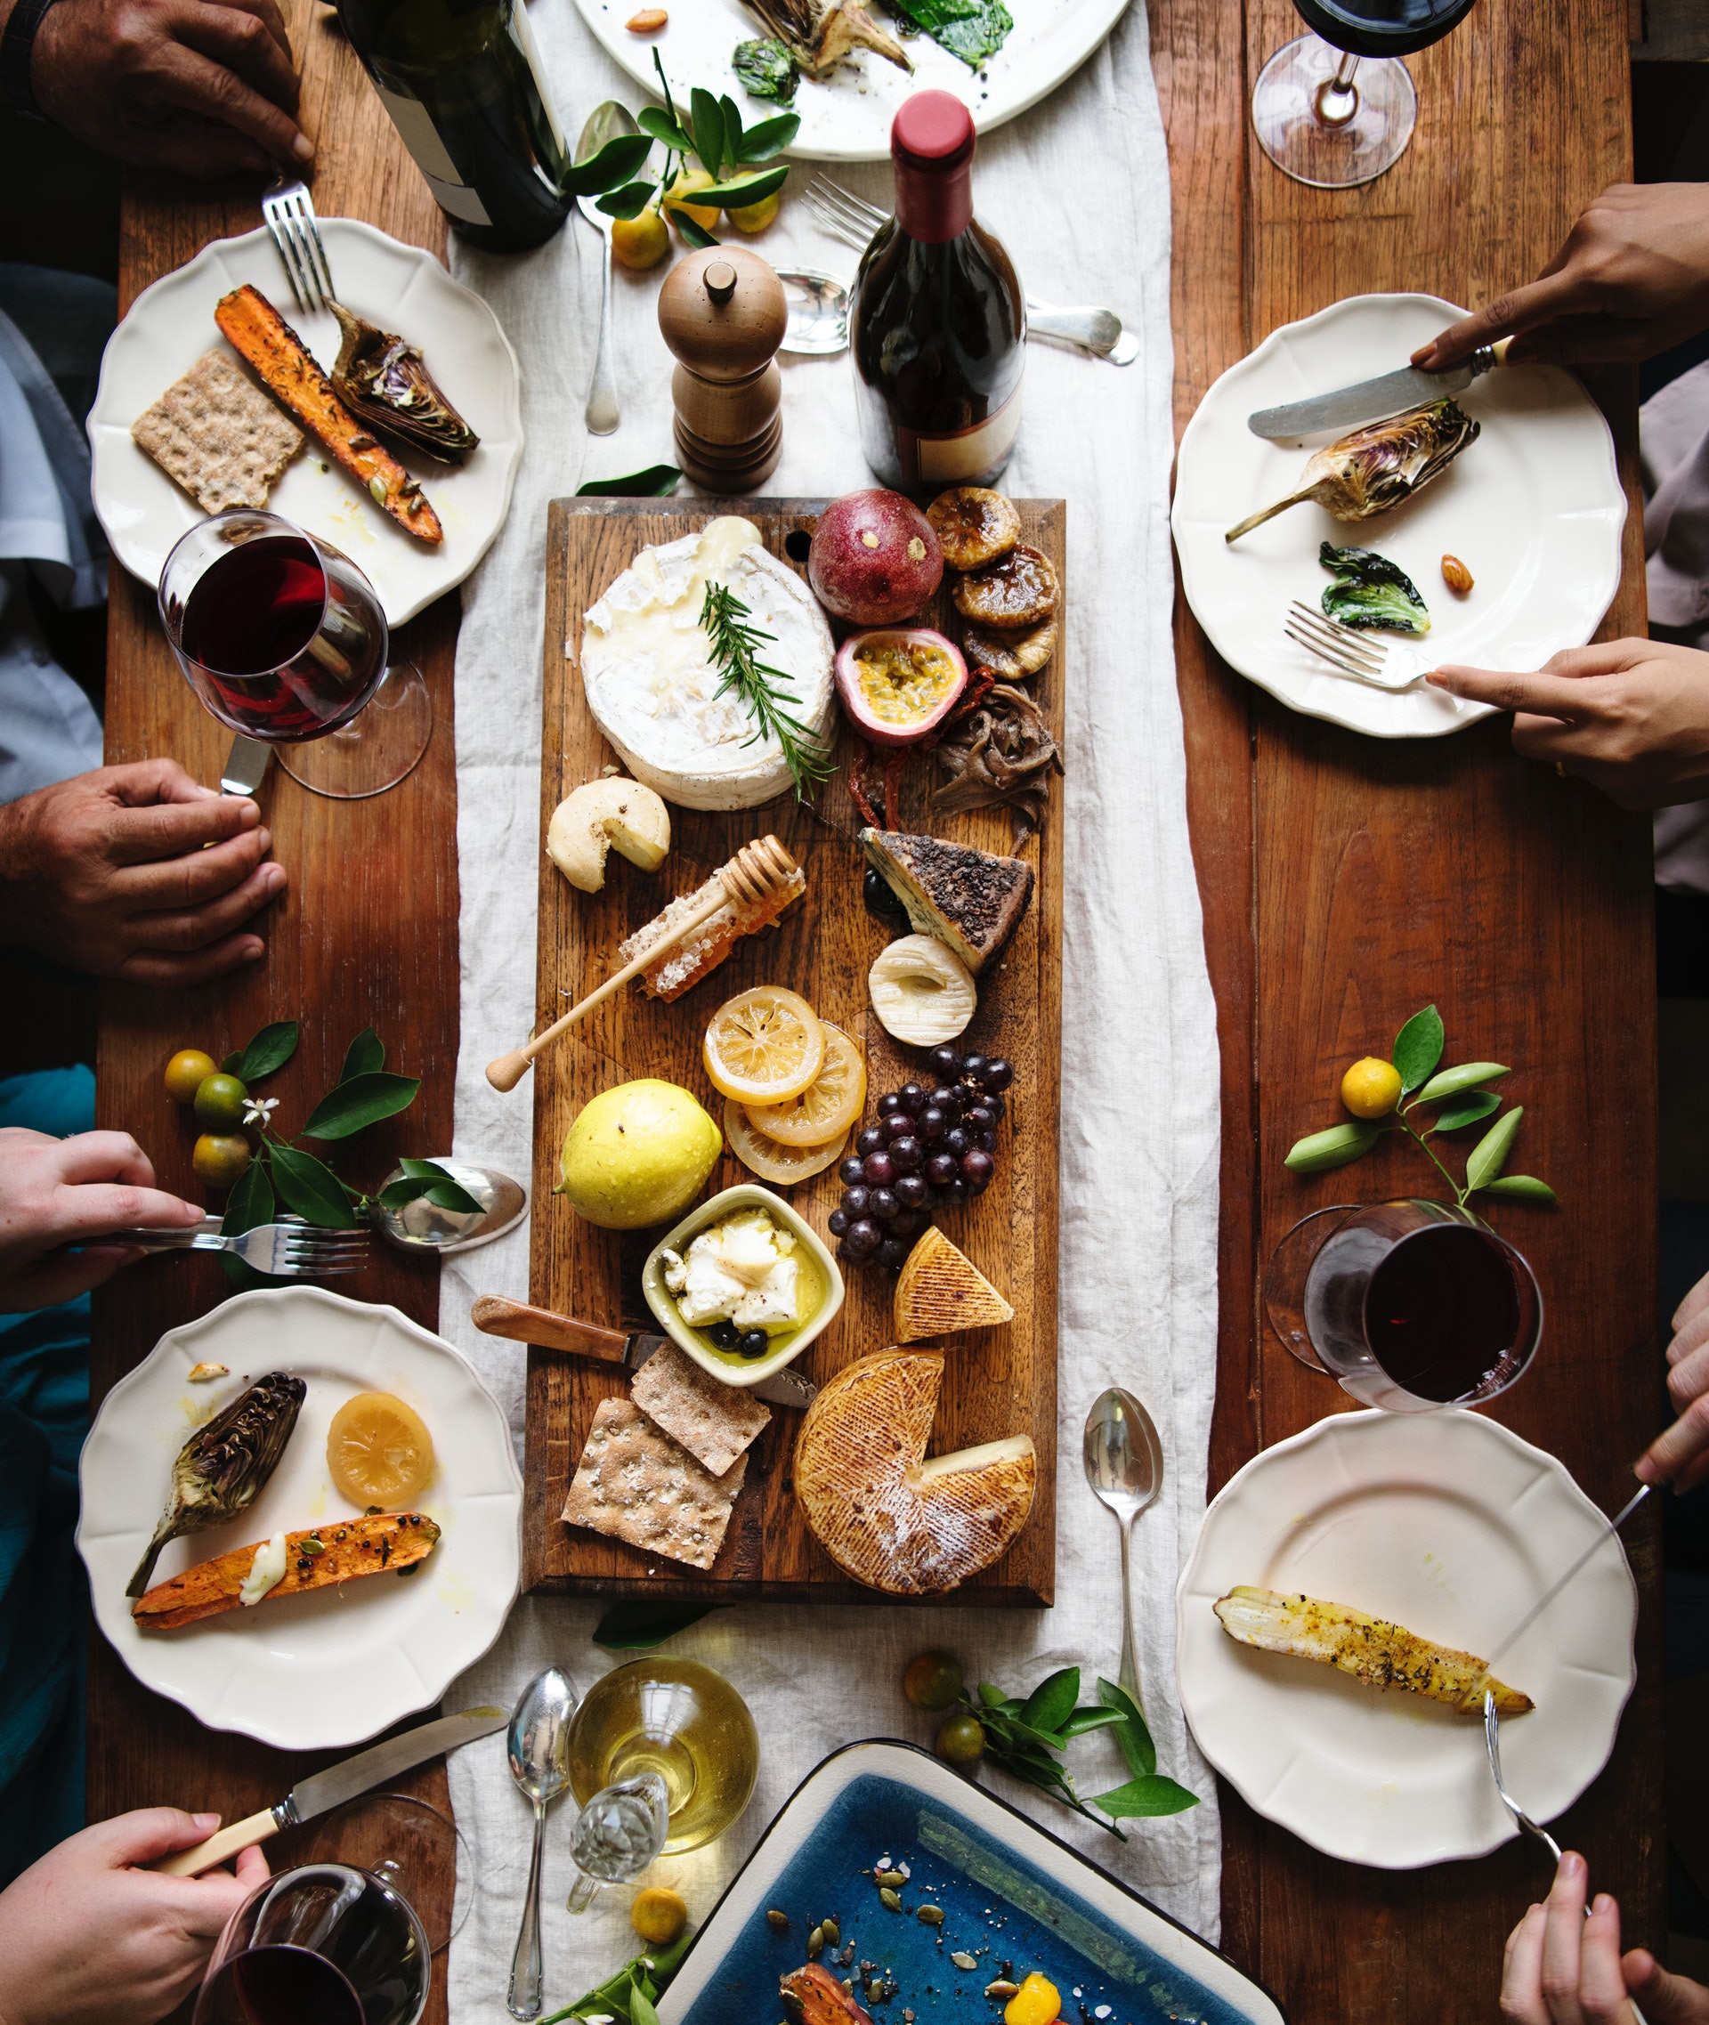
Contributors
Add contributors

